Slide 1

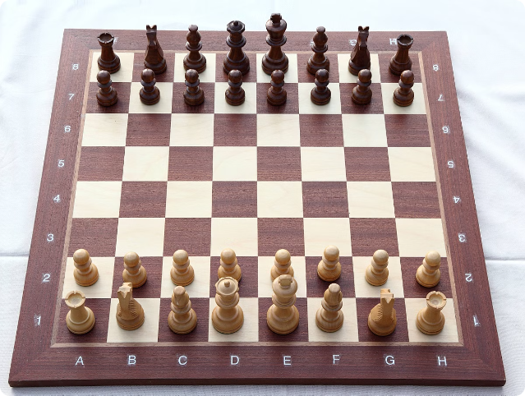


N Queens Visualizer in Java
This project presents a Java implementation of the classic N Queens puzzle, incorporating a visual interface to dynamically represent solutions.
by Abhinav Sharma

Slide 2

Project Overview
1
Problem Definition
2
Solution Approach
The N Queens problem involves placing N chess queens on an N x N chessboard such that no two queens threaten each other.
This project utilizes a backtracking algorithm to systematically explore possible queen placements, identifying valid solutions.
3
Visualization
4
Implementation
A graphical user interface (GUI) provides a dynamic visual representation of the chessboard and queen placement.
The project is implemented in Java, leveraging the Swing library for GUI development.

Slide 3
Problem Statement
The N Queens problem, a classic puzzle in computer science, aims to determine all possible placements of N chess queens on an N x N chessboard such that no two queens can attack each other.
Constraints
Objective
Complexity
Queens cannot occupy the same row, column, or diagonal.
The objective is to find all possible configurations that satisfy these constraints.
The problem's complexity grows exponentially with increasing N, making efficient algorithms essential.

Slide 4

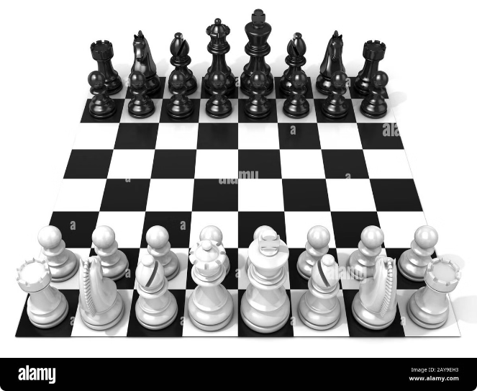
Algorithmic Approach
The project employs a backtracking algorithm to solve the N Queens problem, systematically exploring potential queen positions while ensuring that no conflicts arise.
1
Initialization
An empty N x N chessboard is initialized.
2
Placement
The algorithm attempts to place a queen in the first column. If a position is safe, it's marked.
3
Backtracking
If a conflict arises, the algorithm backtracks to the previous column and tries a different position.
4
Solution
If all queens are placed without conflicts, a valid solution is found, and the process repeats until all solutions are discovered.

Slide 5

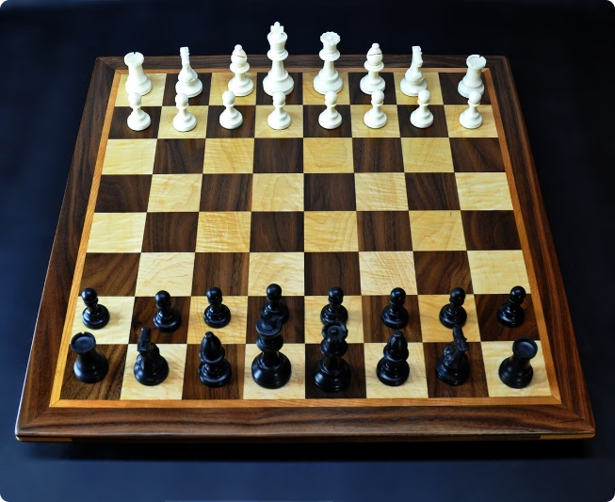
Implementation Details
The N Queens visualizer is implemented in Java, leveraging the Swing library for GUI development. The core algorithm is implemented in a separate class, allowing for clear separation of concerns.
Class
Purpose
Chessboard
Represents the N x N chessboard, handling queen placement and conflict detection.
NQueensSolver
Implements the backtracking algorithm, searching for valid solutions.
Visualizer
Handles GUI creation and updates, displaying the chessboard and solutions.

Slide 6

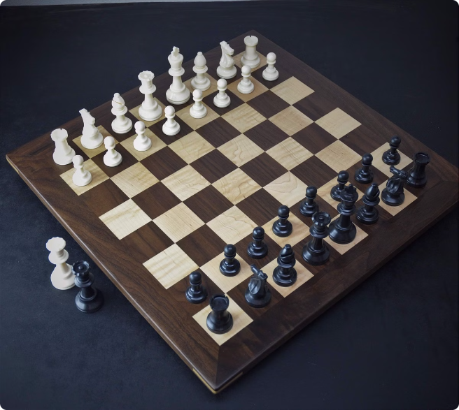



Visualization Techniques
The visualizer utilizes a dynamic representation of the chessboard, allowing users to interact with the solution process and visualize the placement of queens.
Chessboard
The chessboard is displayed using a graphical representation, with each square color-coded to indicate its state.
Queens
Queens are visually depicted on the board, their positions updated as the algorithm progresses.
Solution Highlight
Valid solutions are highlighted on the board, allowing users to easily identify successful queen placements.

Slide 7


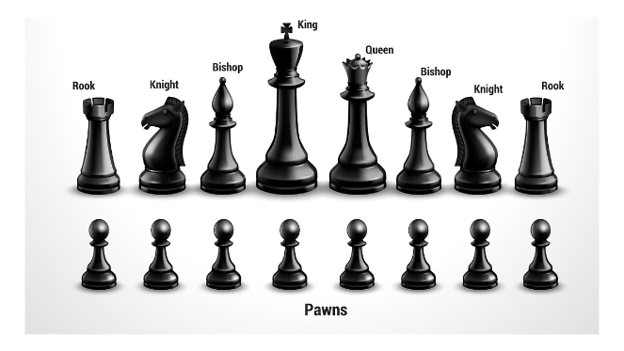


Challenges and Considerations
Implementing a visualizer for the N Queens problem presented challenges related to optimization, user experience, and the need for clear and effective visual representation.
Performance Optimization
Optimizing the backtracking algorithm was crucial to handle larger values of N efficiently.
User Interface
Designing an intuitive and engaging user interface was important for a positive user experience.
Visual Clarity
Ensuring a clear and visually appealing representation of the chessboard and solutions was critical.

Slide 8

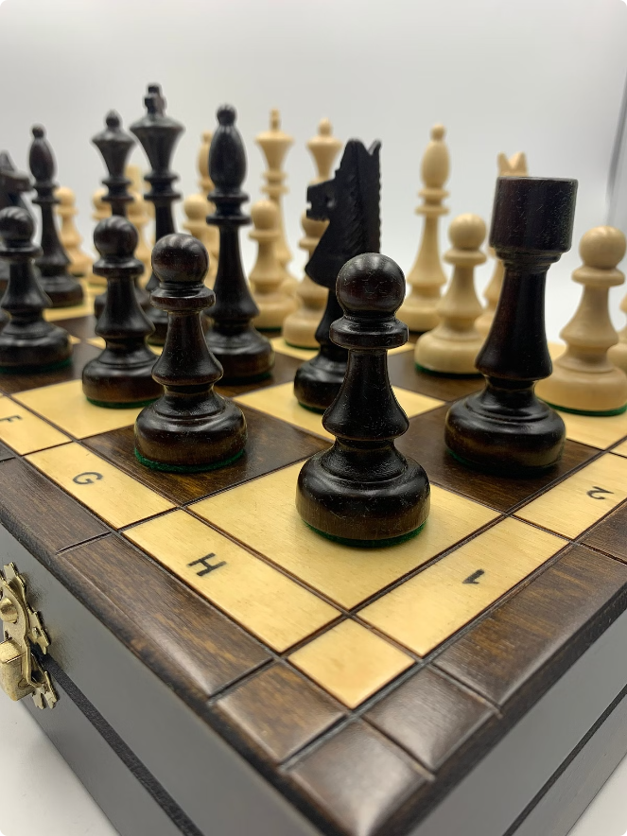
Conclusion and Future Enhancements
In conclusion, the N Queens Visualizer project has successfully demonstrated the implementation of the backtracking algorithm to solve the classic N Queens problem. By leveraging the power of Java and the Swing library, we have created a dynamic and interactive application that allows users to explore and understand the solution process.
Key Achievements
Efficient backtracking algorithm to find all valid solutions for the N Queens problem
Intuitive and visually appealing user interface that enhances the understanding of the problem
Separation of concerns between the core algorithm, chessboard representation, and visualization components
Future Enhancements
As we look ahead, there are several potential enhancements that could be explored to further improve the N Queens Visualizer:
Support for larger board sizes to showcase the scalability of the algorithm
Additional visualization features, such as step-by-step animation or performance metrics
Exploration of alternative algorithms or optimization techniques to enhance the solution process
Incorporation of user input and customization options to allow for a more personalized experience
By addressing these future enhancements, the N Queens Visualizer can continue to be a valuable tool for understanding and exploring the fascinating world of the N Queens problem.

